Slide 1
Customer Loan Defaults Using AI Algorithms for a Fictitious Shantanu Bank of Singapore”
“Predicting
Venu Gopal Madhav Annamdas, PhD

Slide 2
TABLE OF CONTENTS
01
04
02
05
03
06
Sneak peek
Project Statement
Data on the Map
Modeling
Business Goals
:Towards Solns
Data Insights
Conclusions

Slide 3
INTRODUCTION
Shapes the economy.
Solves needs of people → housing, cars, education etc
Setback: Non-payment can jeopardize
(a) financial institutions
(b) nation
'

Slide 4
01
Problem Statement
Statement: To develop AI models to predict the likelihood of a customer defaulting on a loan. This is crucial for any financial institution to minimize the
(1) risk exposure and make (2) informed lending decisions.
Notes:
Trust based decisions to Informed lending decisions

Slide 5
Dataset Details
Dataset
The dataset contains historical data for the past 10 years which includes customer's financial information, employment status, and work experience
Impact
Modified to suit local geography
Analysis-SET
3.8 MILLION SIZE (Data-2012 to 2023)
Basic Dataset Source : https://www.kaggle.com/datasets/subhamjain/loan-prediction-based-on-customer-behavior

Slide 6

DATA ARCHITECTURE
Kaggle dataset +Local Geography
Data
EDA
Decision (data insights)
Modeling
Interpretation
Communication

Slide 7
DATA FEATURES: INDEPENDENT
['Age’,
'Experience’,
'Married/Single’,
'House_Ownership’,
'Car_Ownership’,
'Profession’,
'CURRENT_JOB_YRS’,
'CURRENT_HOUSE_YRS’,
'District’, 'Latitude', 'Longitude’,
'Income_SGD’, ‘Loan_loss’]
'Risk_Flag',
87.7% Vs 12.3%
Modified to local Geography

Slide 8


Business Goals
Notes:
Bankers Need a Robust Reliable loan default prediction system that not only reduces financial risk but also enhances its reputation and competitiveness in the market.

Slide 9
Business Goals
Risk Mitigation: (loss prevention)
2. Improved Decision-Making:
3. Customer-Centric Approach:
4. Cost Reduction:
5. Improved Portfolio Management
Notes:
Bankers Need a Robust Reliable loan default prediction system that not only reduces financial risk but also enhances its reputation and competitiveness in the market.

Slide 10


Data Insights

Slide 11
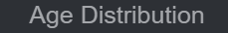
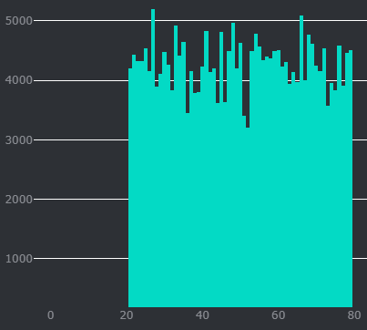
Observations/ Applicants
The applicants are between
20 years to 80 years.
Shows that all age groups want to get loans for their various financial needs in a similar way
Age

Slide 12
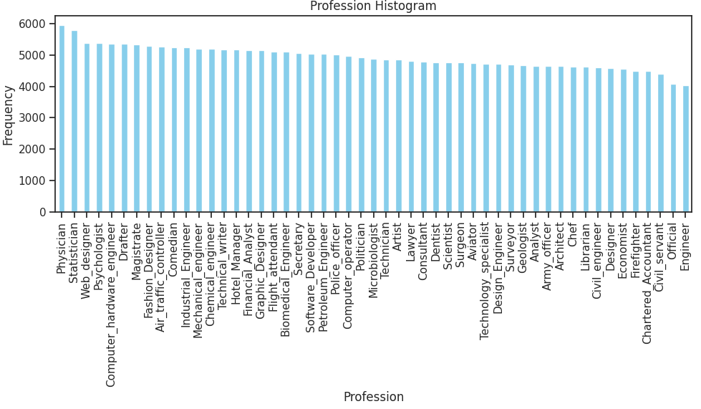
Predicting Customer Loan Defaults Using AI Algorithms
51 TYPES
In several countries, loans are based on ‘professions’. Such as
Education loans for students.
Clinical Equip. Loans for Physicians
Clinic Est. for Dentists ….
So it is important to understand the types of customers

Slide 13
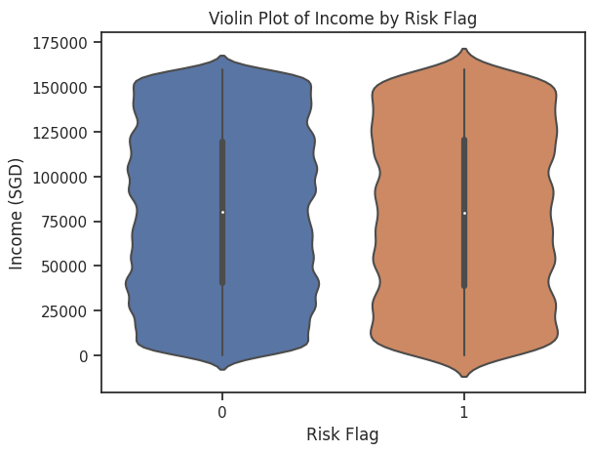
Predicting Customer Loan Defaults Using AI Algorithms
The income range of customers
Settled loans Vs. Defaulted
are similar……
Loan settled by Poor, MiddleLoans income, and Rich (Risk Flag=0)
Defaulted also are either Poor, Middle-income range or Rich (Risk Flag=1)

Slide 14
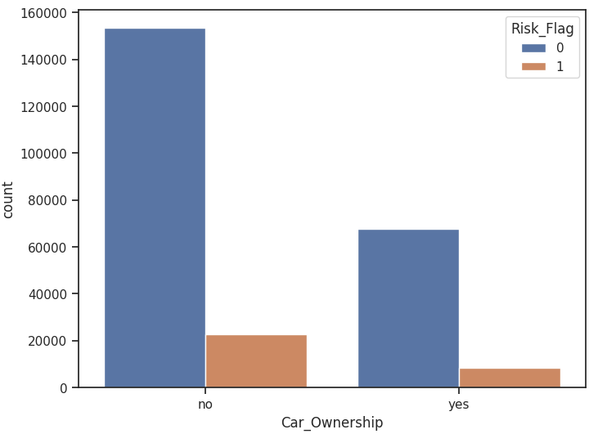
Predicting Customer Loan Defaults Using AI Algorithms
150k customers without cars settled their loans and
20k customers without cars defaulted their loans
60k customers with cars settled their loans and
6k customers with cars defaulted their loans

Slide 15
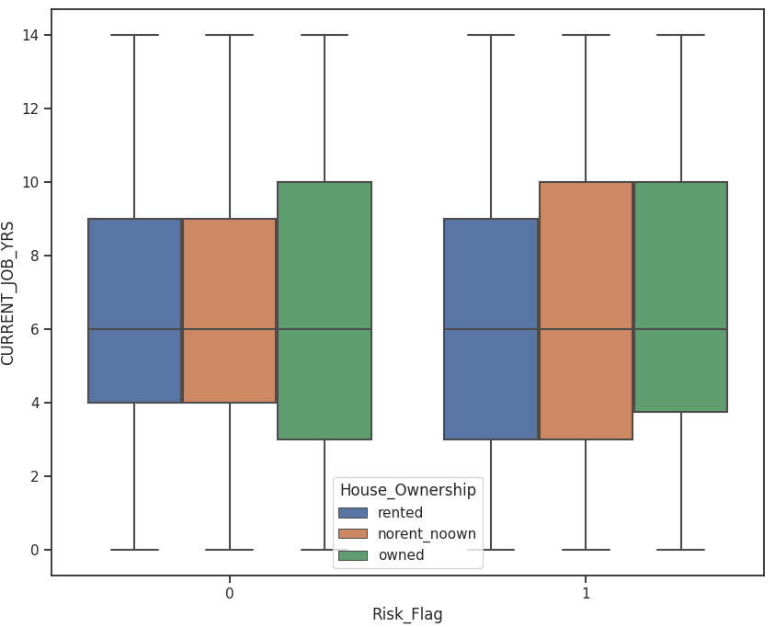
Predicting Customer Loan Defaults Using AI Algorithms
Loans settled Vs Loan Defaulted
50% of homeless people with current job experience between 4-9 years, settled their loans
50% of homeless people with current job experience between 3-10 years, defaulted their loans

Slide 16
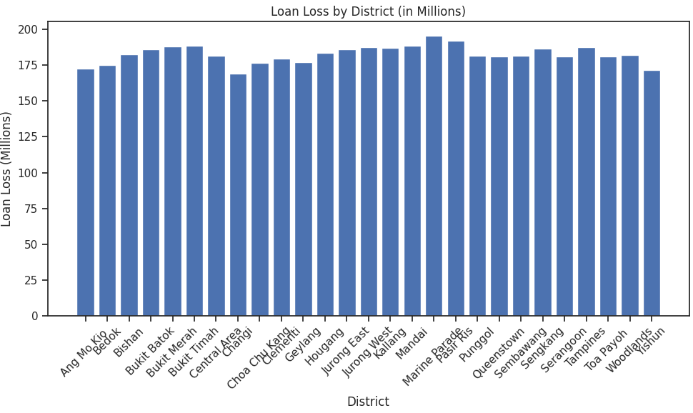
To avoid Losses all districts need such prediction systems

Slide 17
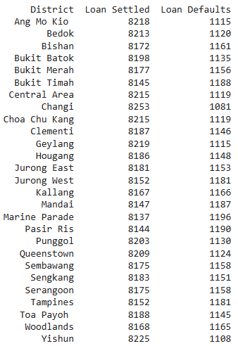
District wise Information

Slide 18

Sneak Peek
Singapore
Data on the Map
Shantanu Bank of Singapore

Slide 19
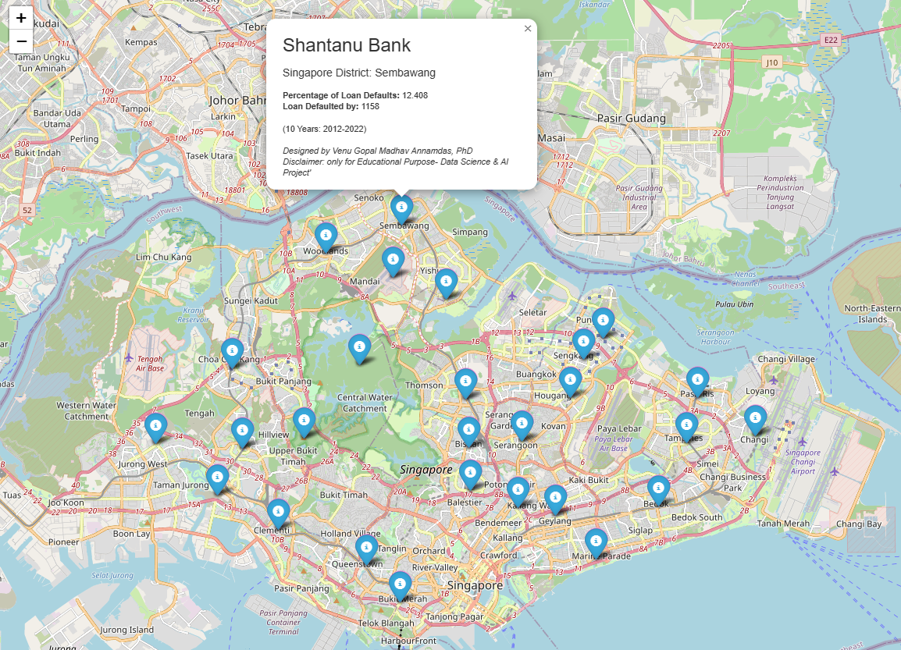
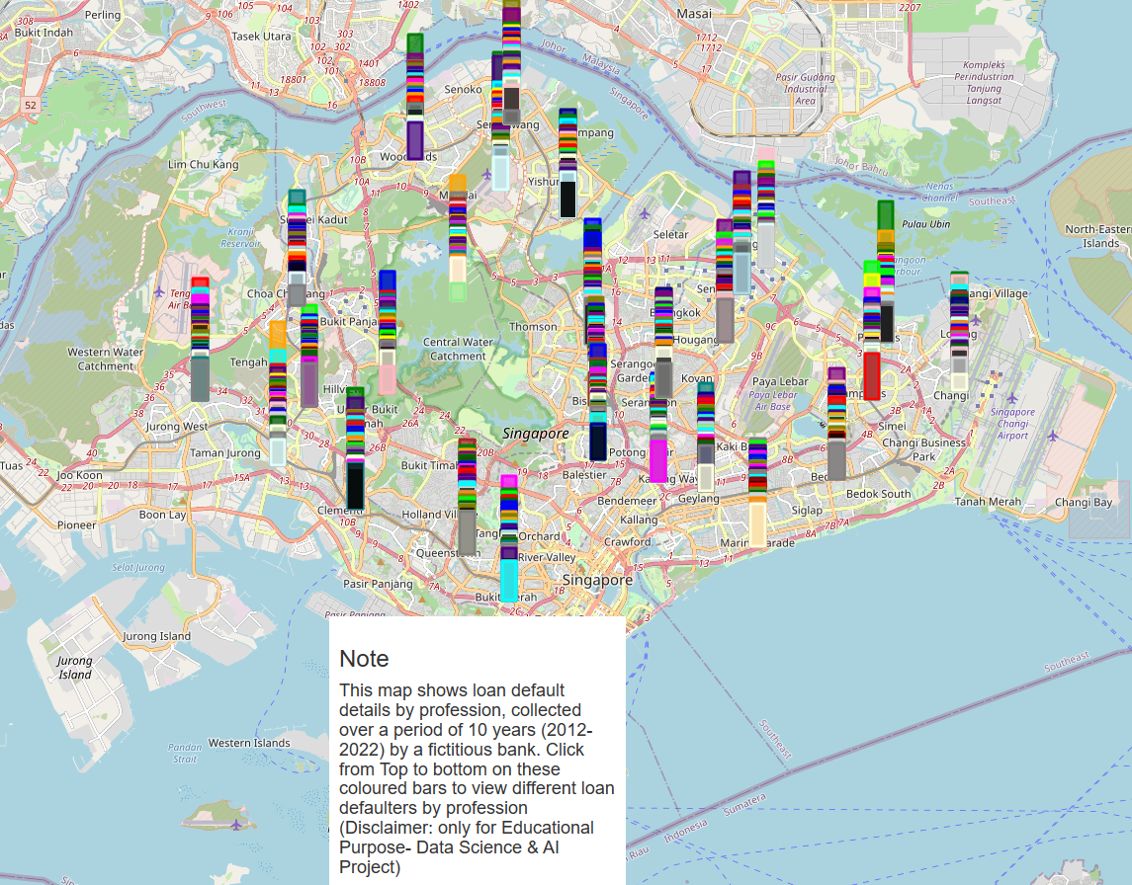
Data on the Map
raw.githack.com/venuannamdas/Singapore_Bank_Loan_Project/master/DataScience_AI_Banking_Project.html
raw.githack.com/venuannamdas/Singapore_Bank_Loan_Project/master/DataScience_AI_Banking_Project_Default_Details.html

Slide 20

Modeling

Slide 21
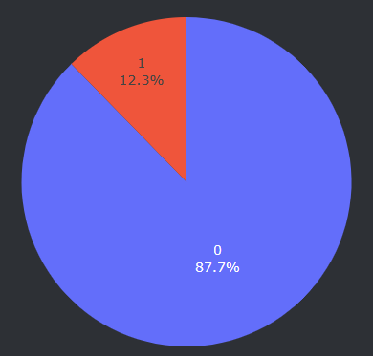
Data Preparation for Modelling
→Features in X , Target in y
X = 'Age’,
'Experience’,
'Married/Single’
'House_Ownership’,
'Car_Ownership’,
'CURRENT_JOB_YRS’,
'CURRENT_HOUSE_YRS’, ‘Income_SGD’
y =Risk_Flag 0 221004 1 30996

Slide 22
AI Modelings adopted for Prediction
Decision Tree Modeling | 1. Class weights adopted 2. Hyperparameter Tuning -Reduced features -class weights adopted
Random Forest | CLASS WEIGHTS adopted
Principal Component Analysis | No class weights
Ensembled Method | Easy Ensemble for Imbalance class (Decision Tree)
Ensabled Method - | Easy Ensemble for Imbalance class-Hyperparameter tuning

Slide 23
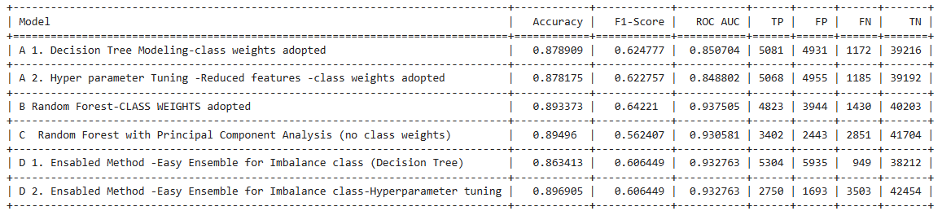

Slide 24
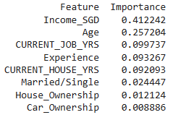
Decision Tree Modeling Ranking of Features

Slide 25
Conclusions
Project Goal
Business Solution
Predicting Customer Loan Defaults Using AI Algorithms
Project Solution
→Robust Reliable
loan default prediction system
Business Goal
To Deploy system with ‘Prediction software’
Risk Mitigation
2. Improved Decision-Making, etc

Slide 26
FUTURE
….We can deploy the system in any financial institution

Slide 27
Thanks

